Slide 1
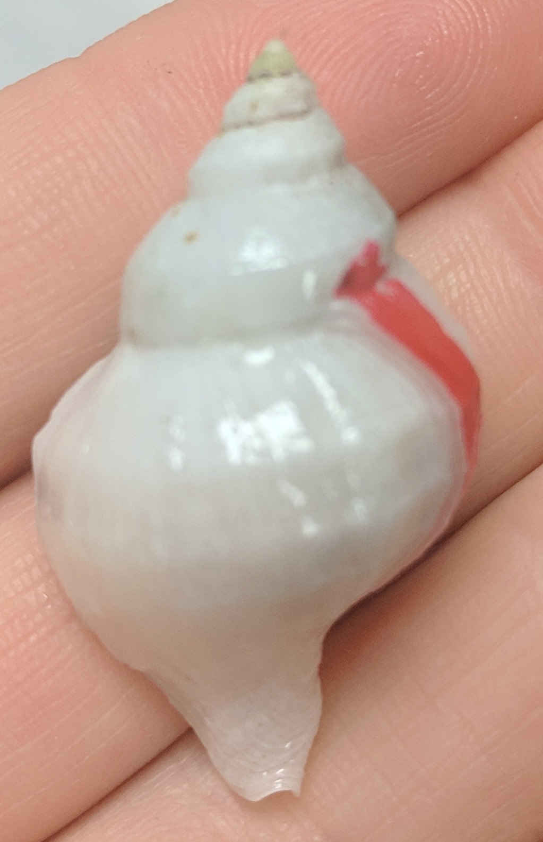
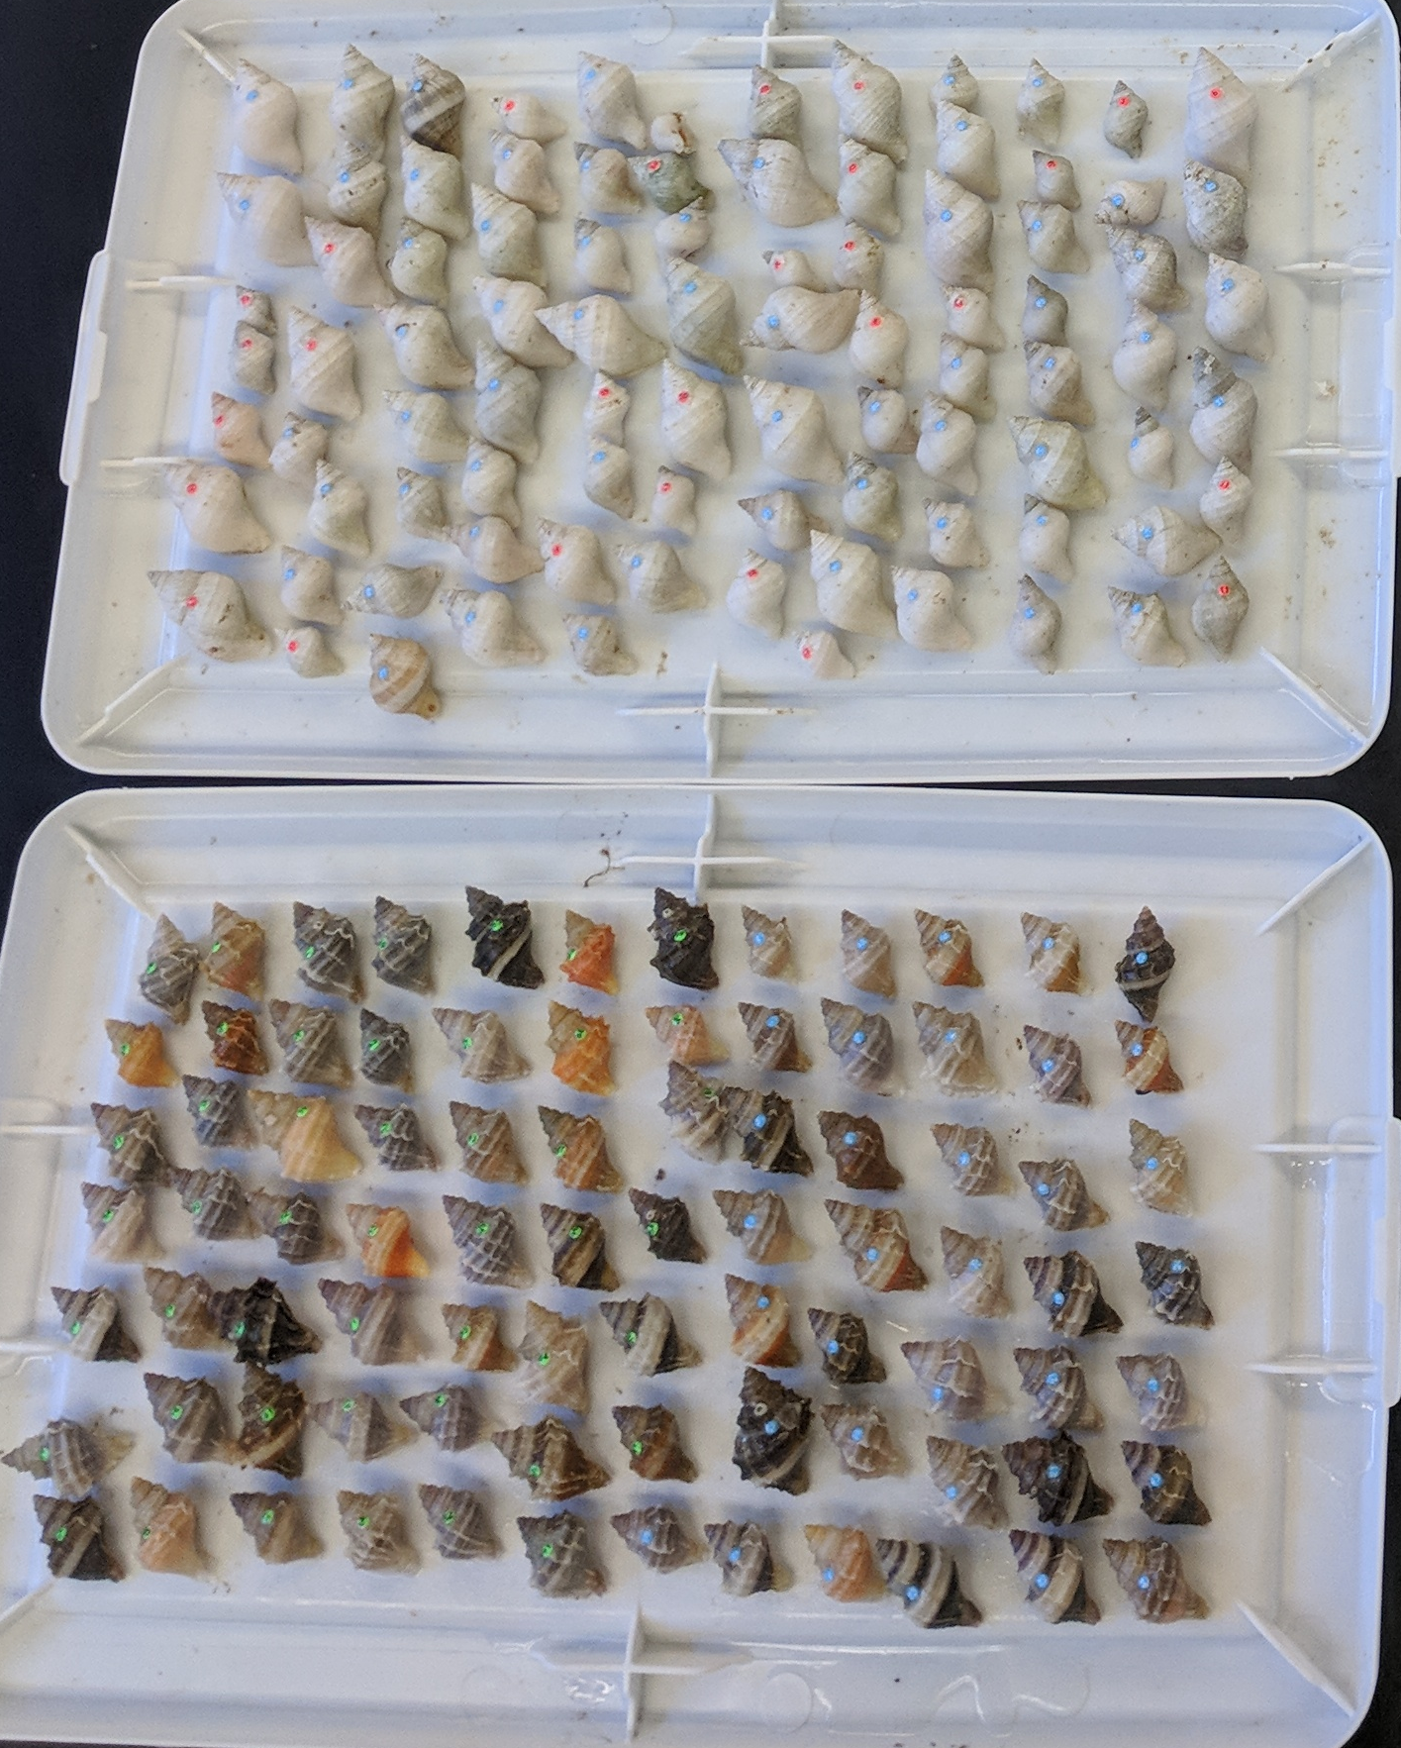
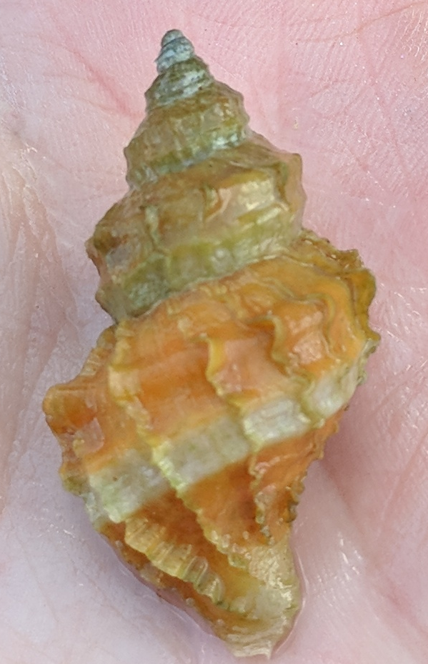
Notes:
Fig x.

Slide 2
Mesocosm experiment design
Reciprocal transplant design
Source region
and population
Temperature
treatment
Group
(tank)
Source region
and population
Outplant
region and site
Group
(block)
Kwak
12
Kwak
Kwak
Central Coast
Pruth
15
Pruth
Pruth
K
P
K
P
C
H
C
H
Number
of snails
n = 7
Number
of snails
n = 6
Cedar
19
Cedar
Cedar
Strait of Georgia
Heron
22
Heron
Heron
fully crossed
fully crossed
Notes:
Fig S1

Slide 3
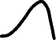

Mesocosm
Reciprocal transplant
A
C
Source region
Central Coast
Strait of Georgia
performance
B
D
E
current
future
CC
SoG
CC
SoG
temperature
outplant region
Notes:
Fig 1. Predictions associated with the mesocosm experiment (A,B) and reciprocal transplant (C-E). Populations from the Central Coast are indicated in black squares and populations from the Strait of Georgia in grey circles. Acronyms are as follows: current seawater temperature (CT), future seawater temperature (FT), Central Coast (CC) ahd Strait of Georgia (SoG). Panel A shows predictions that align with the climate variability hypothesis, where populations from the Strait of Georgia are less vulnerable to future seawater temperatures because they have evolved greater thermal breadths. Panel B shows predictions that align with the trade-off hypothesis, where populations from the Strait of Georgia are more vulnerable to ocean warming because of energetic trade-offs associated with maintaining higher thermal tolerance. Panels C-E show outcomes where populations from both regions perform better (e.g. grow and survive more) when outplanted on the Central Coast relative to the Strait of Georgia. Panel C also shows signals of local adaptation, where populations from each region perform better when they are outplanted in their native environment relative to foreign populations. In Panel D both regions show signs of maladaptation to their native environments relative to the foreign regions, while E shows populations from the Central Coast outperforming Strait of Georgia populations in both regions.

Slide 4
Source region
Calvert
Nanaimo
Local adaptation
performance
Plasticity
(or non-divergence)
phenotype
Calvert
Nanaimo
CA
CL
WA
WL
Reciprocal transplant
Temperature
Factorial
Notes:
Predictions figure

Slide 5
Local adaptation
Fitness
Plasticity
(or non-divergence)
Phenotype
Calvert
Nanaimo
12
15
19
22
15A
15L
22A
22L
Outplant region
Temperature
Treatment
Notes:
Predictions figure

